Slide 1

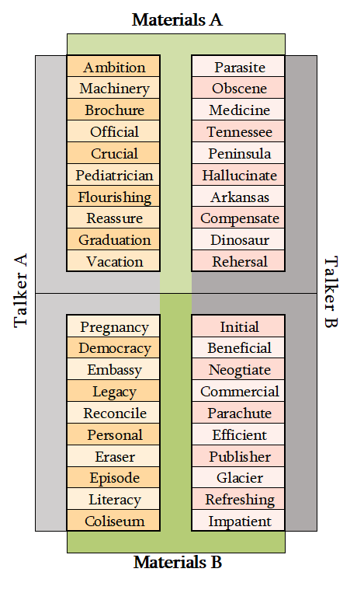
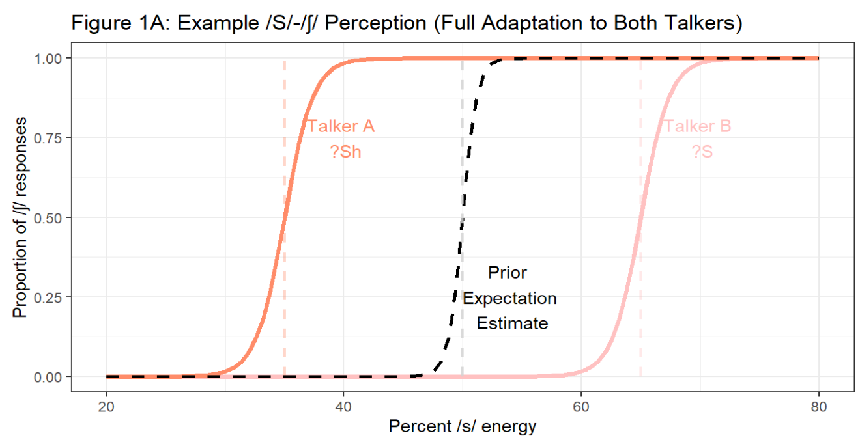
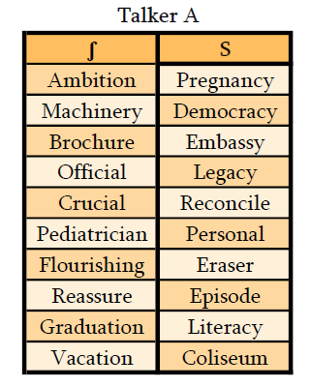
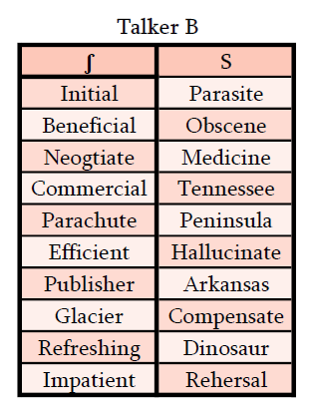
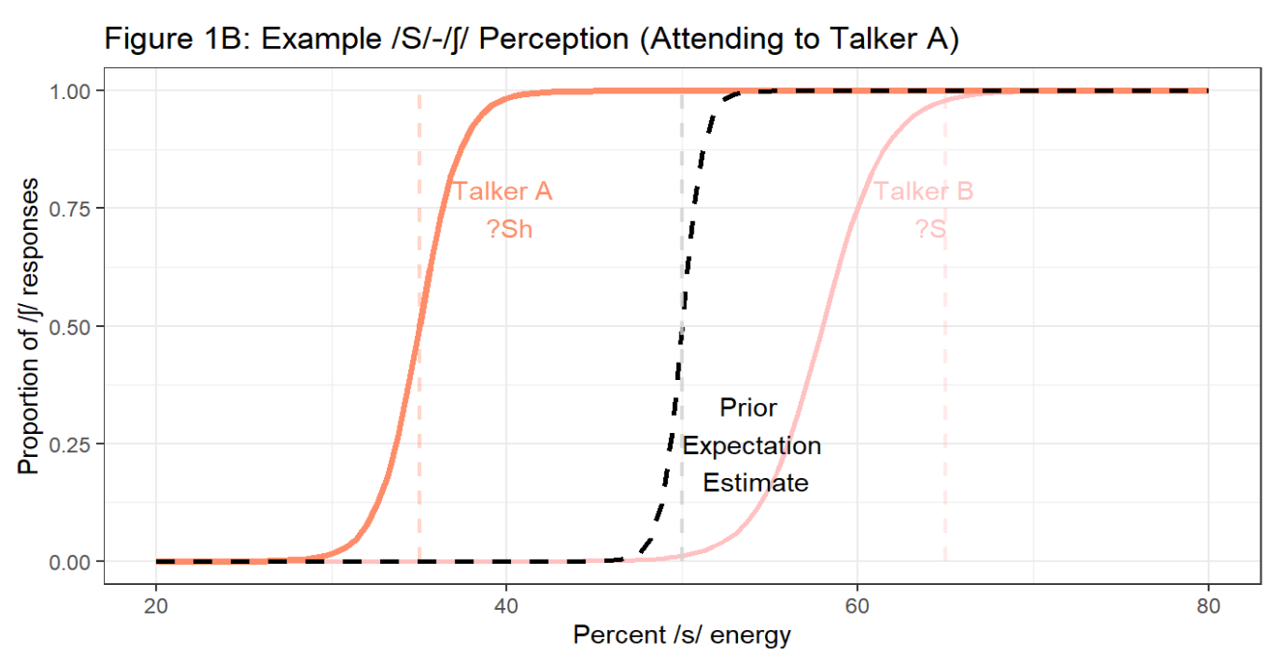



Background
Exploring the Automaticity Speech Perception and Adaptation
Spoken language is highly variable by nature. Talkers differ in how they produce speech sounds, even when they share similar language backgrounds. Still, listeners understand newly encountered talkers when hearing them speak for the first time. To overcome speech variation, the brain actively learns how talkers speak, and constructs expectations about how that talker will produce speech in the future. Though this process often occurs without the listener noticing, how automatic speech perception adaptation is remains unclear. In this experiment, we will limit the available attentional resources for speech perception by exposing a listener to two talkers speaking simultaneously. We will then test the effects of directing the listener’s attention to one talker on the listener’s ability to adapt to both talkers.
Rachel Sabatello¹, Shawn Cummings², & Florian Jaeger¹
¹University of Rochester, Department of Brain and Cognitive Sciences
²University of Connecticut, Speech, Language, and Hearing Sciences
Design
In this study, we will be measuring listeners’ perceptual adaptation to two simulated talkers’ S-ʃ production.
S-ʃ sounds exist on a continuum, spanning from /s/ as in “Sock” to /sh/ as in “Shock.” Earlier research suggests that listener adaptation to talker S-ʃ production is talker-specific. This means that listeners adjust their perceived boundary between S-ʃ for each talker regardless of other talkers the listener may also hear (Kraljic & Samuel, 2005). This quality could allow us to simulate two distinct talkers with different S-ʃ productions during the same experimental exposure (Cummings & Theodore, 2022).
Hypothesis
Critical Trials
Exposure Phase
Our critical stimuli are created from 40 recordings of S/ʃ words, each spoken typically (S, Sh) and accented (?S, ?Sh) (Kraljic & Samuel, 2005).
Talker A and Talker B recordings were paired to create Materials A and Materials B. Half of the participants will hear the words in Materials A with the simulated accent (?S, ?Sh), and the words in Materials B without the accent (S, Sh). The other half of the participants will hear the inverse, meaning Materials B will be accented and Materials A will not be (See below).
We hypothesize that speech perception adaptation is contingent upon attention. If there are limits to the automaticity of speech perception, then we expect listeners will adapt their perceived categorical boundary to align better with the speech of the talker they are instructed to attend to compared to the unattended talker.
All recordings were processed using Praat (Boersma, 2002) to simulate the words being spoken by a male talker and a female talker (Luthra et al., 2021).
The word pairings shown horizontally across in Materials A & B were then spliced together to create stereo audio files where one talker is played in the left ear, and the other in the right ear. Like talker gender, ear assignment was counterbalanced across participants.
Predictions
These words were split in half to create two sets of words representing two talkers:10 unique S words and 10 unique ʃ words were allocated to each talker (see below).
Filler Trials
Each experiment consists of 80 total exposure trials, including 20 critical trials and 60 filler trials. During filler trials, one talker will say a word and the other talker will say a nonword. Each talker has a 50% chance of saying a nonword.
Paradigm
Participants will be instructed to attend to either the female talker or the male talker. They will then perform a series of 2-option forced-choice lexical decision tasks, in which they hear a recording and then select on their screen if this talker said a word or a nonword (see below).
Figure 2: Lists of s and ʃ words that will be produced in Talker A’s and Talker B’s voice, respectively.
Listen
Select
Each experiment will have a male and a female talker: If Talker A is female, then Talker B is male.
If Talker A is male, then Talker B is female.
Figure 4: Static representation of how a participant will progress through a trial. Each trial will begin with the participant hearing an audio file and then selecting either “Word” or “Nonword”.
Figure 3: Visual illustrating how the words spoken by Talker A and Talker B will be paired to produce two sets of materials.
Test Phase
ashi
asi
Figures 1A & 1B: Graphical representations of listeners responses to the asi-ashi test continuum during the Test Phase. As the percent of energy of /s/ in the recording increases, the more likely participants are to respond “ashi” (/ʃ/), rather than “asi” (/s/). If perceptual adaptation is dependent on attentional resources, we anticipate the listener will adjustment to the unattended talker will be constrained.
After the Exposure Phase, participants will hear the asi-ashi test continuum across trials in each talker’s voice. This continuum is used to gauge when listener’s shift from perceiving a sound as “Sh” to “S” (see left). Each trial will only play a recording from a single voice at once. Participants will select if the audio they heard was “asi” or “ashi” for each trial, to produce results like the predictions, shown to the left.
Sh
?s
?sh
S
Figure 5h: “S” and “Sh” sounds exist on a spectrum, where “asi” can be altered to sound like “ashi” by changing the percentage of /s/ energy.
Implications
References
Acknowledgements
The results of this experiment begin to explore the role of attention in speech perception adaptation. A listener’s perceptual boundary changing more to fit the attended talker’s speech than the unattended talker’s speech would suggest there are limits to the automaticity of speech perception and may also provide insight into how our brains allocate attentional resources under higher cognitive loads.
Boersma, P. (2002). Praat, a system for doing phonetics by computer. Glot International, 5(9/10), 341–345.
Cummings, S. N. & Theodore, R. M. (2022). Perceptual learning of multiple talkers: Detriments, characteristics, and limitations. Attention, Perception, & Psychophysics.
Kraljic, T., & Samuel, A. G. (2005). Perceptual learning for speech: Is there a return to normal?. Cognitive psychology, 51(2), 141-178.
Luthra, S., Mechtenberg, H., & Myers, E. B. (2021). Perceptual learning of multiple talkers requires additional exposure. Attention, Perception, & Psychophysics, 83, 2217–2228.
Tzeng, C. Y., Nygaard, L. C., & Theodore, R. M. (2021). A second chance for a first impression: Sensitivity to cumulative input statistics for lexically guided perceptual learning. Psychonomic Bulletin & Review, 28, 1003–1014.
Thank you to Dr. Tanya Kraljic and Dr. Arthur Samuel for permission to use the stimuli they had developed (Kraljic & Samuel, 2005), the 2022 Meliora Mentors, and the University of Rochester Brain & Cognitive sciences department.
This project was funded by the University of Rochester Wiesman summer fellowship in brain and cognitive sciences.

